Slide 1
WPF Data Binding
Notes:
References:
https://docs.microsoft.com/dotnet/framework/wpf/data/data-binding-wpf
https://app.pluralsight.com/course-player?course=wpf-fundamentals&author=ian-griffiths&name=wpf-data&clip=0&mode=live

Slide 2
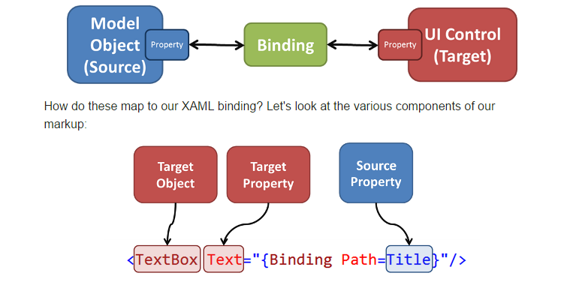
WPF Data Binding
Powerful tool to automate the connection between the data and the view of that data

Slide 3
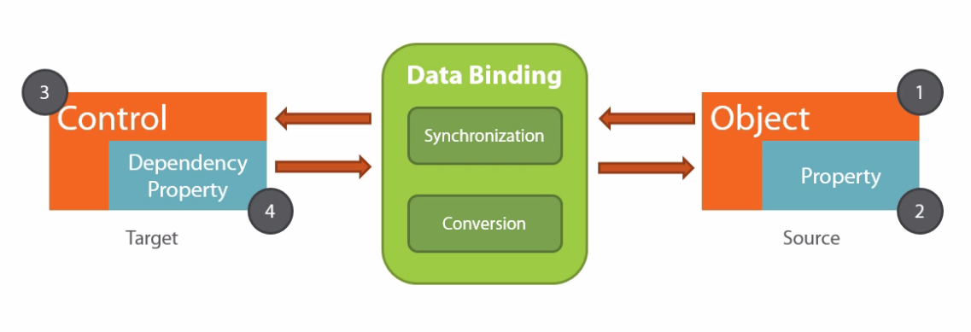
WPF Data Binding
For example: bind the content of a TextBox to the Name property of an Employee object →
Target DependencyObject = TextBox
Target DependencyProperty = Text property
Binding Source Object = Employee
Binding Source Object Property = Name
Notes:
WPF Data Binding
Any databinding is always composed out of 4 important building blocks.
On one hand we have the source of the binding. This will be an object. And in this object, data is available in properties. So the source will be number one and the source property will be number 2.
On the other hand we have a UI control to which we’re binding our data. This control is the target of the binding. On these controls, we have a specific type of properties named dependency properties. Most properties on UI controls are in fact dependency properties so we will be able to use most of them in data binding statements. The UI control, so the target control is number 3, and its dependency property is the target property and that will be number 4.
The most important thing to see here, is that, in order to function, the data binding needs to have these 4 building blocks assigned. When 1 is missing, the databinding will not work.

Slide 4
WPF Data Binding
Data flow of binding can go from the binding target to the binding source (e.g. user edits value of a text box), from the binding source tot the binding target (e.g. TextBox’s content updating when changes in the binding source occur), or both
Notes:
WPF Data Binding
Our data can flow from the source to the target. Visa versa, data can also flow from the target to the source. This could be for example when the user has entered a new value in a text box in the UI. If this source object implements the correct interface, then the databinding engine will make sure that the source and the target stay in sync. Also, the databinding engine gives us a hook in the data binding process through conversions. Which can happen on our data if needed. This could be for example a formatting happening on a string we need to display in the UI.

Slide 5
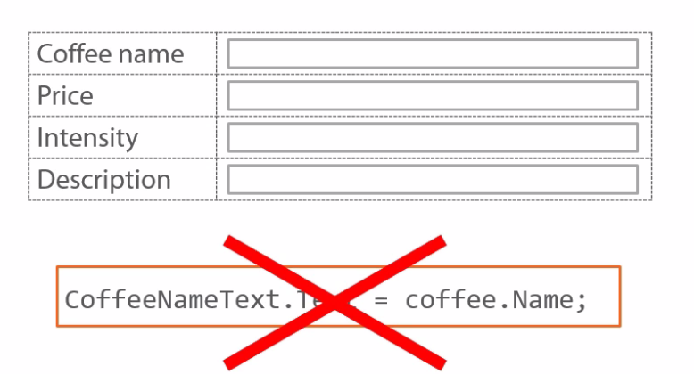
Binding a single object
Notes:
Showing details of a particular coffee

Slide 6
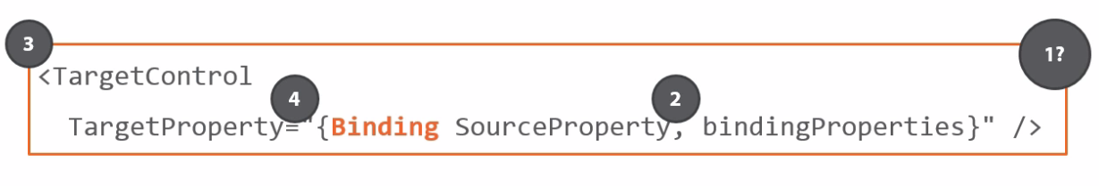
Binding a single object
Notes:
Building a single object
We need to create a data binding declaration. Most databindings are created declaratively in XAML, and typically we have the format you see here on the slides.
You have the target control, that is number 3.
We need to specify which property we are databinding, so that is number 4.
Next we are creating the databinding itself and we can do so by creating a binding object. And specify the name of the property we are bind it to. And that will be number 2. Also we can pass optionally some extra binding properties. The syntax with the curly braces you see here, is called in itself a markup extension. What this means is that behind the scenes a binding object is being instantiated and it is attached an object in the xaml tree but in itself it is not part of the xaml tree. So we have here number 2, number 3, number 4 but we are missing the number one, the source of the binding. We’ll come to this is just a second. First let see some applied samples of data binding statements. In this line of code here, we have a textblock and its text property is being databound. We are binding it to the property CoffeeName and we add mode=OneWay to the properties of the binding. Notice here that I’m using Path=CoffeeName. This is the default way of writing this statement. However, if the source property is the first thing that you write in your binding statement, you can omit this. As you can see here in the last line of code.

Slide 7
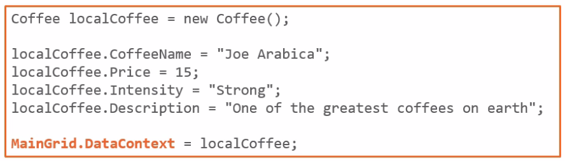
The DataContext
Notes:
The DataContext
Remember that we were missing number 1, we need a source for the binding.
One way to set the source object is by attaching it to the surrounding parent in the UI. So we are setting the source on a common parent.
You can do this by setting the DataContext property of the surrounding element, e.g. a Grid control.
One thing to note that is it very well possible that we declare the datacontext on the direct parent, but you can also declare it higher in the XAML tree.

Slide 8
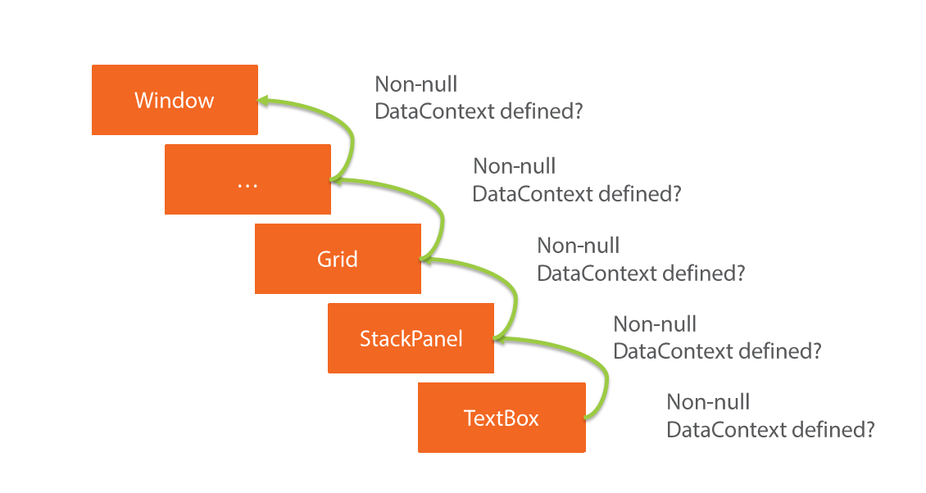
Walking the XAML Tree
Notes:
Walking the XAML Tree
You probably know that XAML is XML and very often objects are nested.
It is very common to have a XAML tree as you can see here on the slide. Take a look at the textbox at the bottom on the screen. It is a direct child of the stackpanel.
This StackPanel in tun is a child of the grid and this grid can also still be nested.
And at the very top of the hierarchy, we have a Window.
In other XAML technologies (like UWP) this could be e.g. a Page.
If we have a databinding statement set on the TextBox, where no Non-Null datacontext has been specified, we’ll see something happening called XAML tree walk.
WPF will look in the parent of the control if a non-null datacontext has been specified on the parent. If so, this one will be used as the source of the binding. If not, it will look a level higher. All the way up untill it reaches the top level control. When it finds a non-null datacontext, it will stop going higher up in the tree.
Know that, if the required properties are not found on the datacontext, it will not search further. It stops with the very first non-null instance of the datacontext.

Slide 9
WPF Data Binding
One Way Binding: source → target
INofifyPropertyChanged interface: underlying data changes → view is updated
Two Way Binding: user can modify data in UI → data updated in the source
Element Binding: bind to another element on the page
DataContext: datasource itself, object whose properties you are binding from
List Binding: Bind collections of data to list boxes, combo boxes,…
Data Templates: tell the list what part of the data to display by using data templates
Data Conversion: converts the data at the source to the type expected at the target
Data Validation : Ensuring that the data is valid

Slide 10
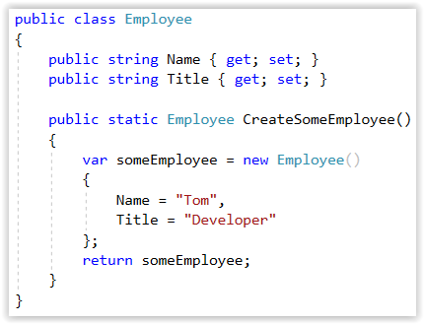
One Way Databinding demo
Employee.cs

Slide 11
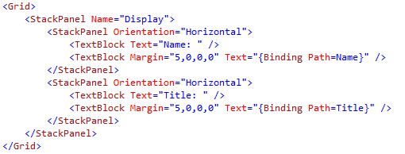
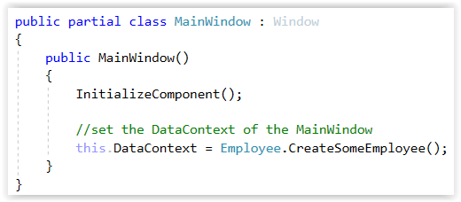
One Way Databinding demo
mainWindow.xaml
mainWindow.xaml.cs

Slide 12
INotifyPropertyChanged Demo
If underlying data changes (for example, by a different user), we want our view to be updated
For example, consider an Employee object with a property called Name. To provide generic property-change notification, the Employee type implements the INotifyPropertyChanged interface and raises a PropertyChanged event when Name is changed.

Slide 13
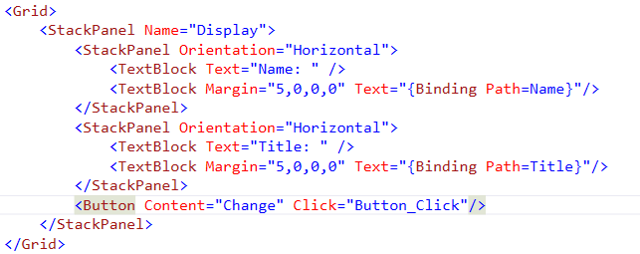
INotifyPropertyChanged Demo
MainWindow.xaml

Slide 14
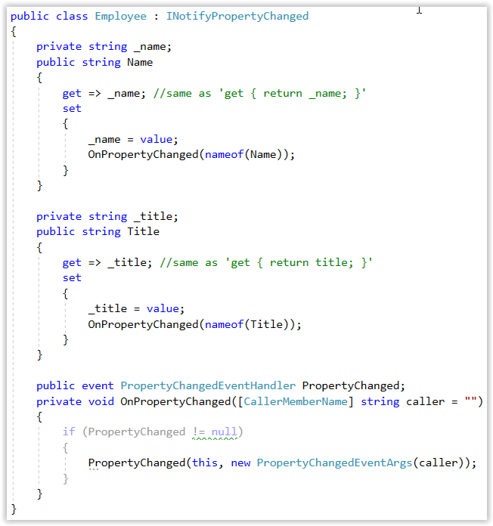
INotifyPropertyChanged Demo
Employee.cs
Notes:
What is this “nameof()” thing?
You can use nameof() to obtain the string name of a variable, type or member.
Using nameof() helps to keep your code valid when those variables, types or members are renamed.
So in the demo we use OnPropertyChanged(nameOf(Name)) instead of OnPropertyChanged(“Name”).
https://docs.microsoft.com/en-us/dotnet/csharp/language-reference/keywords/nameof
What is this “get => _name” thing?
That is an expression body. You can use this to make your code a little bit shorter and more readable.
It means exactly the same as get { return _name; }
https://docs.microsoft.com/en-us/dotnet/csharp/programming-guide/statements-expressions-operators/expression-bodied-members

Slide 15
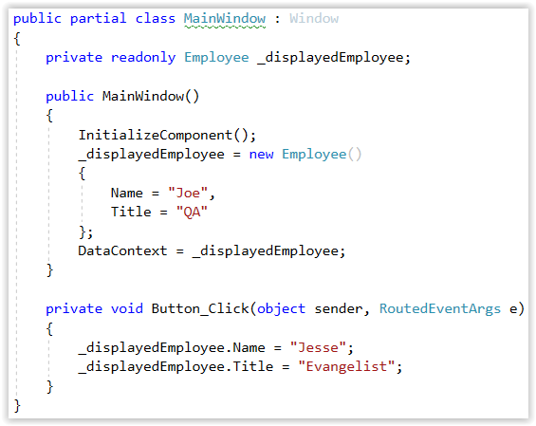
INotifyPropertyChanged Demo
MainWindow.xaml.cs
Notes:
What is that “readonly” keyword?
The readonly keyword is a modifier that you can use on fields.
When a field declaration includes a readonly modifier, assignments to the field can only occur as part of the declaration or in a constructor in the same class.
https://docs.microsoft.com/en-us/dotnet/csharp/language-reference/keywords/readonly

Slide 16
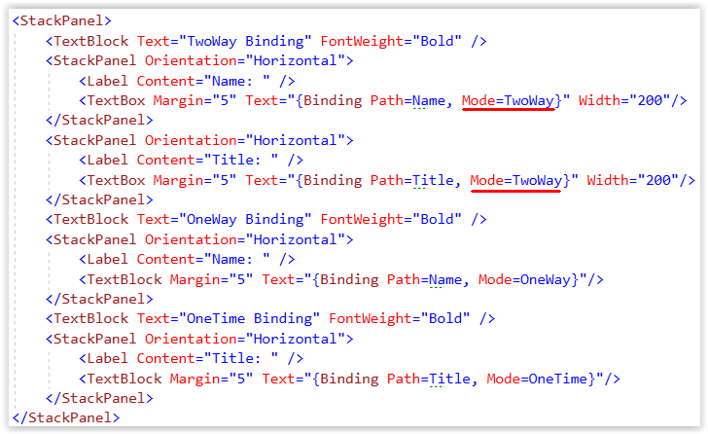
Two Way DataBinding Demo
MainWindow.xaml: Mode=TwoWay
Notes:
Two Way Databinding
OneWay bindings only propagate changes in the source value to the target (assuming the source implements INotifyPropertyChanged)
TwoWay binding propagates changes in both directions, ensuring that the two values are always synchronized.

Slide 17
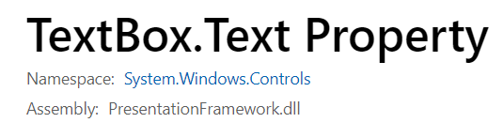
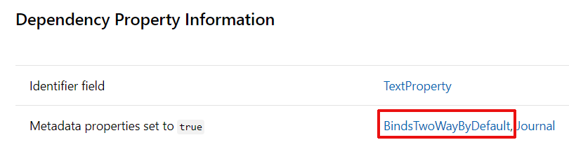
Default Binding Mode
When no Binding Mode is set, the mode “Default” is used
Uses the default binding mode of the target property
E.g. TwoWay for Text property of TextBox
E.g. OneWay for Text property of TextBlock
Look up the property in the documentation and find the Dependency Property Information section
BindsTwoWayByDefault -> TwoWay binding
Otherwise -> OneWay binding
Not sure what the default mode is -> specify it explicitly!

Slide 18
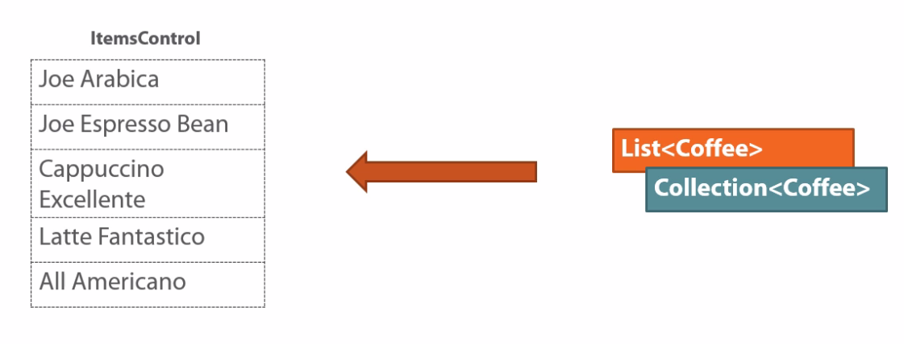
Binding Collections

Slide 19
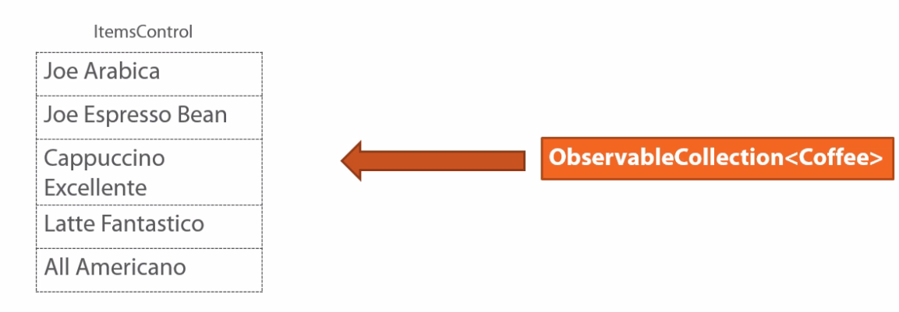
The ObservableCollection<T>
Notes:
The ObservableColection<T>
If you would like to see updates to the collection, resulting in updates in the items control, you can use a different class, named ObservableCollection<T>.
For now, just remember that if your databinding an observable collection to your items control, that changes to the collection (so adding or removing items) will result in the list being updated in the UI as well.

Slide 20
Important properties on ItemsControl
ItemSource
Collection of data objects to display in each item
Default= the result of the ToString method of the data object is displayed in each item
DisplayMemberPath
Property of the data object to display in each item
ItemTemplate
Block of XAML (DataTemplate) to display in each item
DataContext of the item is the data object
ItemsPanel
Layout container for all the items
Notes:
Important properties on ItemsControl
When binding a collection, there are number of important properties which take part in the data binding proces.
The first one is the ItemsSource property. The itemsSource property is defined on the ItemsControl class, and is therefore available on all UI list controls. Using this property, you can specify which items we want to display in our list. If we simple bind the data to our control using the itemsSource property, we’ll only see the result of the “ToString” method on each object being used for the visualisation.
If you want to specify which property needs to be displayed we can use the DisplayMemberPath property. Set the value to a property of the object that you are binding to, so for example point it to the name property of a Coffee instance.
We’ll also be discussing the next one in a couple of slides, that is the ItemTemplate. Basically, the ItemTemplate allows us to define a block of XAML, to visualise an item in the list. The itemTemplate allows us to define a block of XAML to visualise an item in a list. So we are overriding the default, which is just using a textblock.
The ItemsPanel is the container for the items in the itemsControl

Slide 21
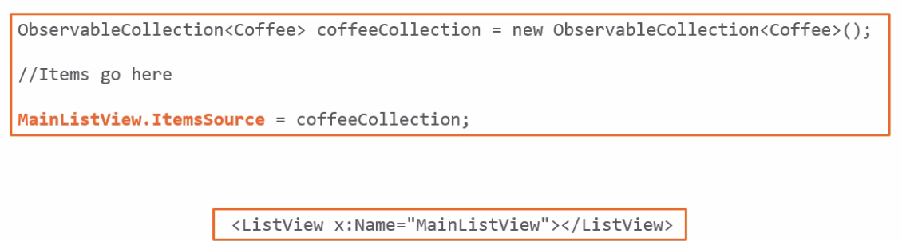
Binding Collections
Notes:
Binding Collections
Lets take a look to the code for binding an observable collection of coffees to a ListView in our UI.
Our ListView has been named MainListView and to bind it to our data, we are using the ItemsSource property and we set it to the observable collection, named coffeeCollection.
The listview is simply declared in XAML and the name is set to MainListView as you can see on the slide.

Slide 22
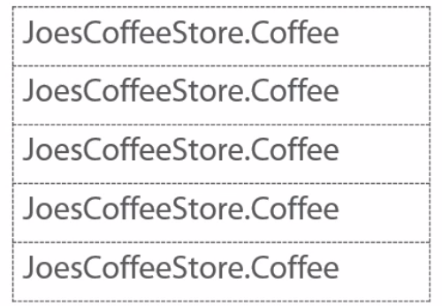
Data Templates
Notes:
Data Templates
Before we look at the next demo, a word on Data Templates.
When you would run the code from the previous slide, so without any specification on which data the listview should be displaying, WPF would simple invoke the ToString Method on each instance.
If this is not overridden in the Coffee class, you would simple see the class name being displayed.
If you use the DisplayMemberPath property and we point it to a property on our object, so can visualise basically one property.

Slide 23
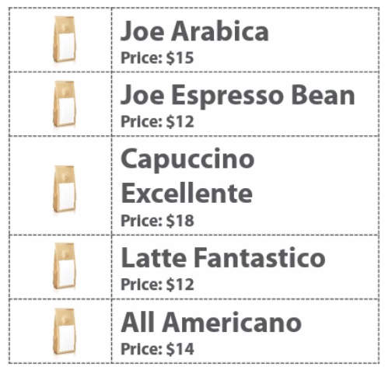
Data Templates
Notes:
Data Templates
Data Templates, as mentioned, give us the abillity to completely override how an item should be displayed in the UI.
The template itself, is the piece of XAML which is repeated for every instance in the collection.
We can put whatever XAML we want in a DataTemplate, so e.g. we can create a grid with an image and 2 textblocks.

Slide 24
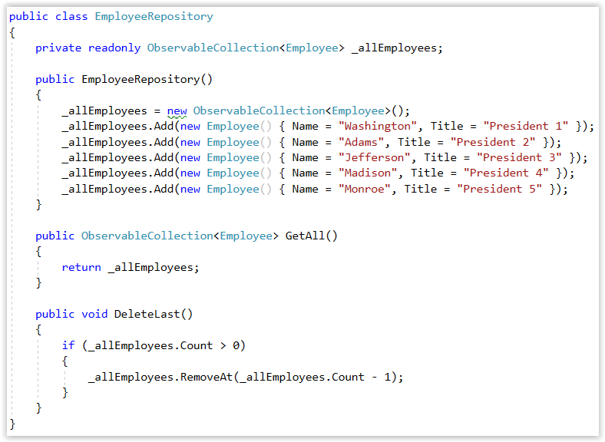
Binding Collections: Demo
ObservableCollection → list will be notified of any addition to or deletion from the collection → will be sent to the view

Slide 25
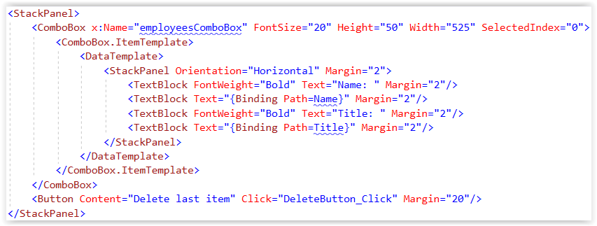
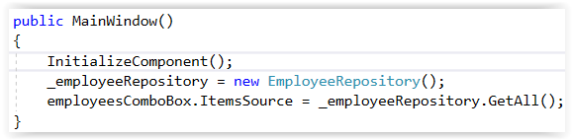
Data Binding Lists Demo
MainWindow.xaml
MainWindow.xaml.cs

Slide 26

Element Data Binding Demo
Binding to the value of another element on the page (instead of the value of an object)

Slide 27
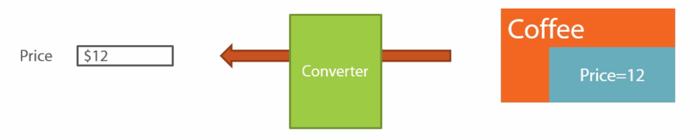
Binding Options: Converters
Notes:
Binding Options: Converters
Let’s take a look at some other options we have at our disposal to influence how the binding works.
A very common used feature is a Converter. As the name implies, it will be converting something from one value to another and that’s exactly what it will be doing in the case of databinding.
Assume again our coffee instance with a value of the price property set to 12. Now, what exactly is that 12. We can’t simple say to the user: the price is 12. Would it be €12, $12, …
By default we can’t specify this. Our converter can come in handy in this type of scenario, It gives us a hook in the databinding proces.
You can capture the value going from the source before it reaches the target and do something with it.
We can for example add a currency symbol and send the combined value to the UI.
We can do many more codings like formatting dates or even convert a string into a color. The sky is the limit and we will see a couple of this in the next demo.
Note that converters also work in 2 ways, just like the binding modes.
Imagine that in a two way binding mode, the value entered by the user contains a currency symbol and the property on or class is of type integer.
We therefore need to remove the currency symbol using that same converter.

Slide 28
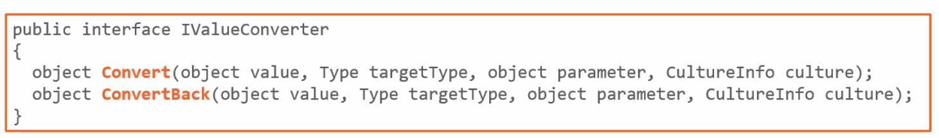
The IValueConverter Interface
Notes:
The IValueConverter Interface
Technically a converter is a class which implements the IValueConverter Interface.
This interface is pretty simple, it contains just 2 methods: Convert and ConvertBack.
The Convert method will be called to transform or convert the data when going from the source to the target. So in the Convert method, you would typically add the currency sign or perform formatting for date values.
The ConvertBack method is only used when we use a two-way binding. So to convert the data going from the target to the source. In this method you would then write code where we remove the currency sign again, so that the value then again can be stored in an integer property.

Slide 29
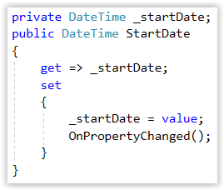
Data Conversion Demo
Data that you wish to bind doesn’t match the display you wish to use
Added to class Employee

Slide 30
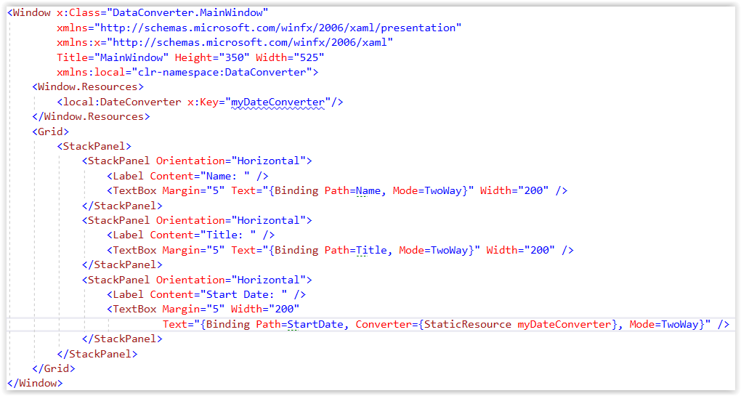
Data Conversion Demo
MainWindow.xaml

Slide 31
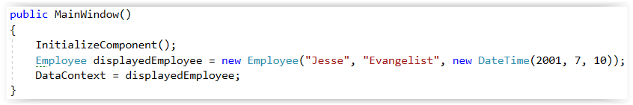
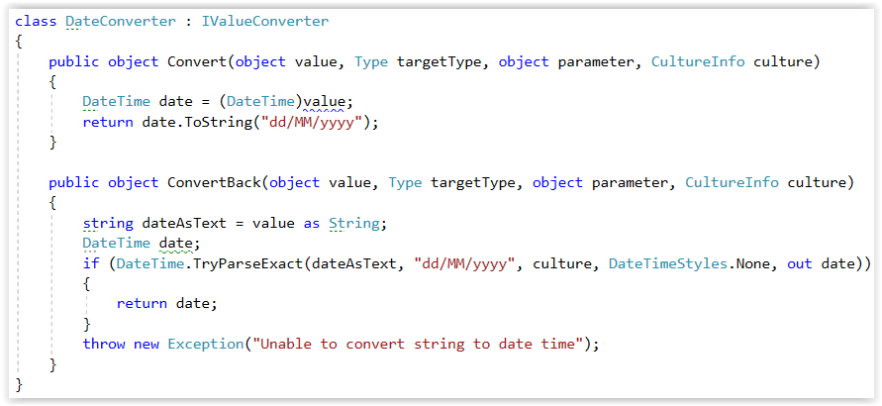
Data Conversion Demo
MainWindow.xaml.cs
DateConverter.cs

